Slide 1




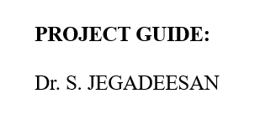
SMART DETECTION OF DEFECTIVE STREET LIGHT

Slide 2
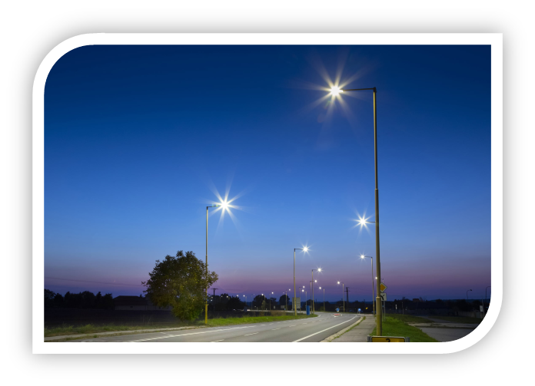
INTRODUCTION
The street lighting system is one of the largest energy expenses for a city. There are many complications when it comes to a defective one. So the project is to reduce the workload for an electrician. The LDR(light-dependent resistor) senses the environment. The system can identify the light or dark environment using LDR

Slide 3

LITERATURE SURVEY
An important component of power consumption worldwide is street lighting. India is no different. Global trends in street lighting show that 18-38% of the total energy bill goes towards street lighting. Therefore this is one domain that needs major attention if we look at improving power consumption efficiency with the objective of saving energy.

Slide 4
EXISTING SYSTEM
Automated fault detection of street lighting using PLC, Street light controlling using PLC is a novel concept using XD26 PLC controller. In this system manual work is not required. Automatic switch ON and OFF of light in response based on sunlight is done by using LDR, which plays a major role. The effect of seasonal variations; increased energy; low operating costs and low maintenance costs are advantages of this method. The testing and analytics of this project with the accurate operation of the streetlights is done.

Slide 5
PROPOSED SYSTEM
The street light control and fault detection with a cloud storage system is implemented through an Arduino program. Nowadays, the street lamps are operated manually. But, the street light control and fault detection with cloud storage system operates the street lamps ON/OFF and finds the fault in the street lamps automatically.

Slide 6
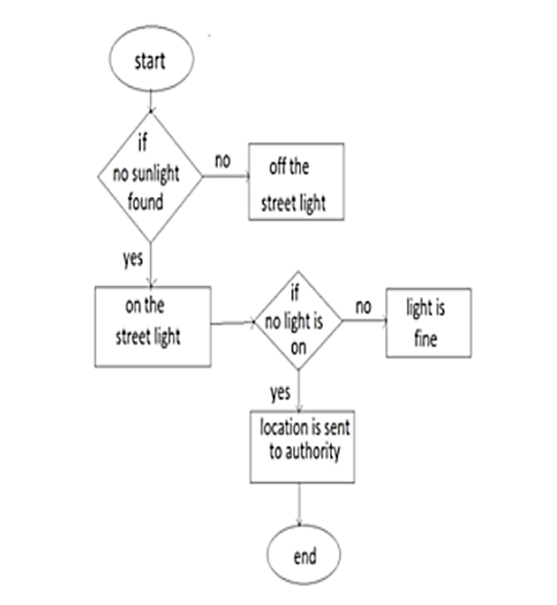
FLOW CHART

Slide 7
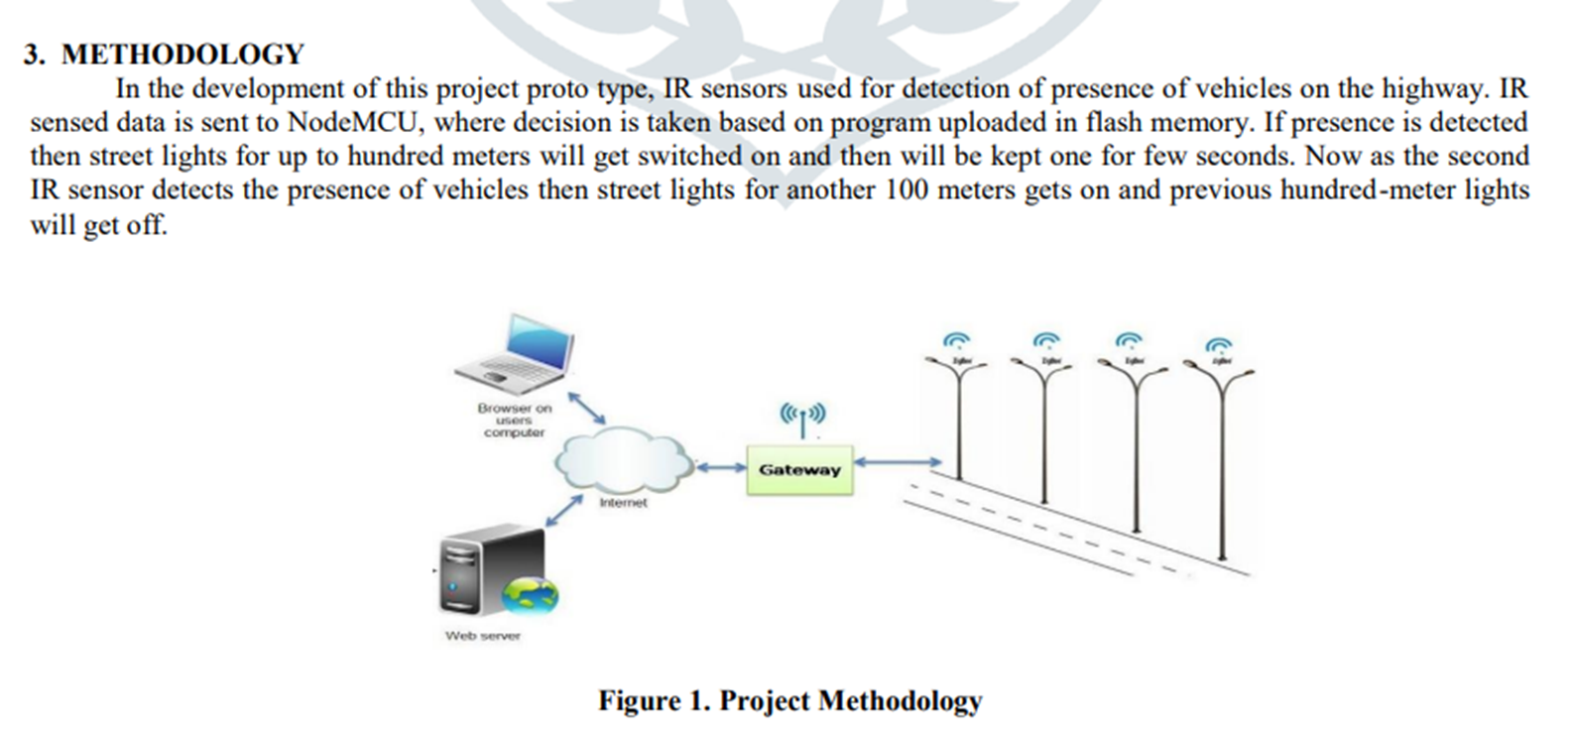

Slide 8

CONCLUSION AND FUTURE SCOPE
An automatic street light control and fault detection system with cloud storage in this paper, controls the street light ON/OFF automatically depending on the environmental situation and we can easily identify the light faults in this system easily also the system sends an alert message to the authorized person’s mobile numbers. In, Future we will find the sensor’s faults and power supply faults in the system and also we will control the light power adjustment depending on the environment.

Slide 9


